Slide 1
World Class Racewalking
Racewalk Training 101

Slide 2
Notes:
All training is about breaking the body down slightly with training, then allowing it to rebuild and make itself stronger upon recovery from the damage.

Slide 3
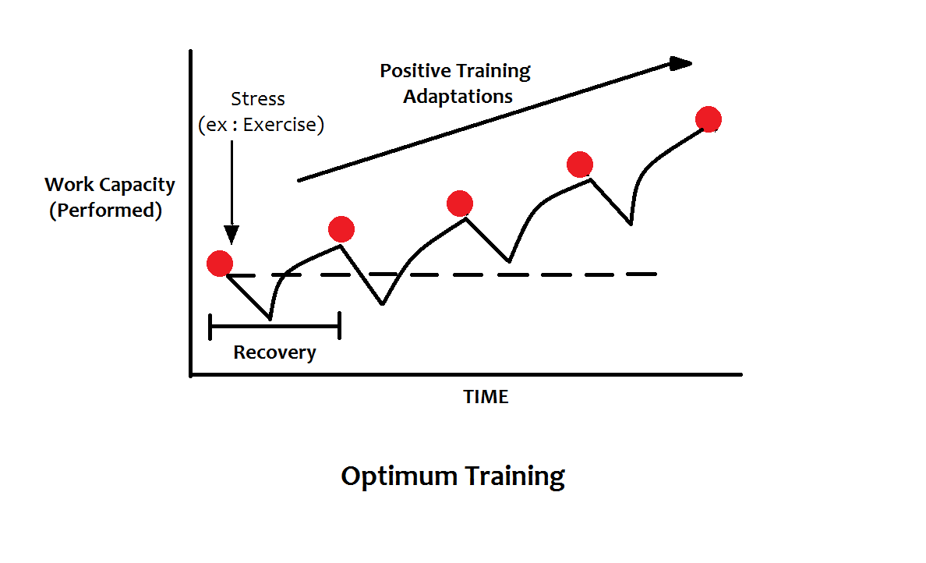
Successive cycles over time:
Notes:
Successive cycles of work, recovery and adaptation over time leads to increased fitness.

Slide 4
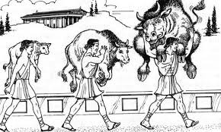
This is:
A. A lot of Bull
B. Going to get messy really soon
C. Milo of Croton
D. All of the above

Slide 5
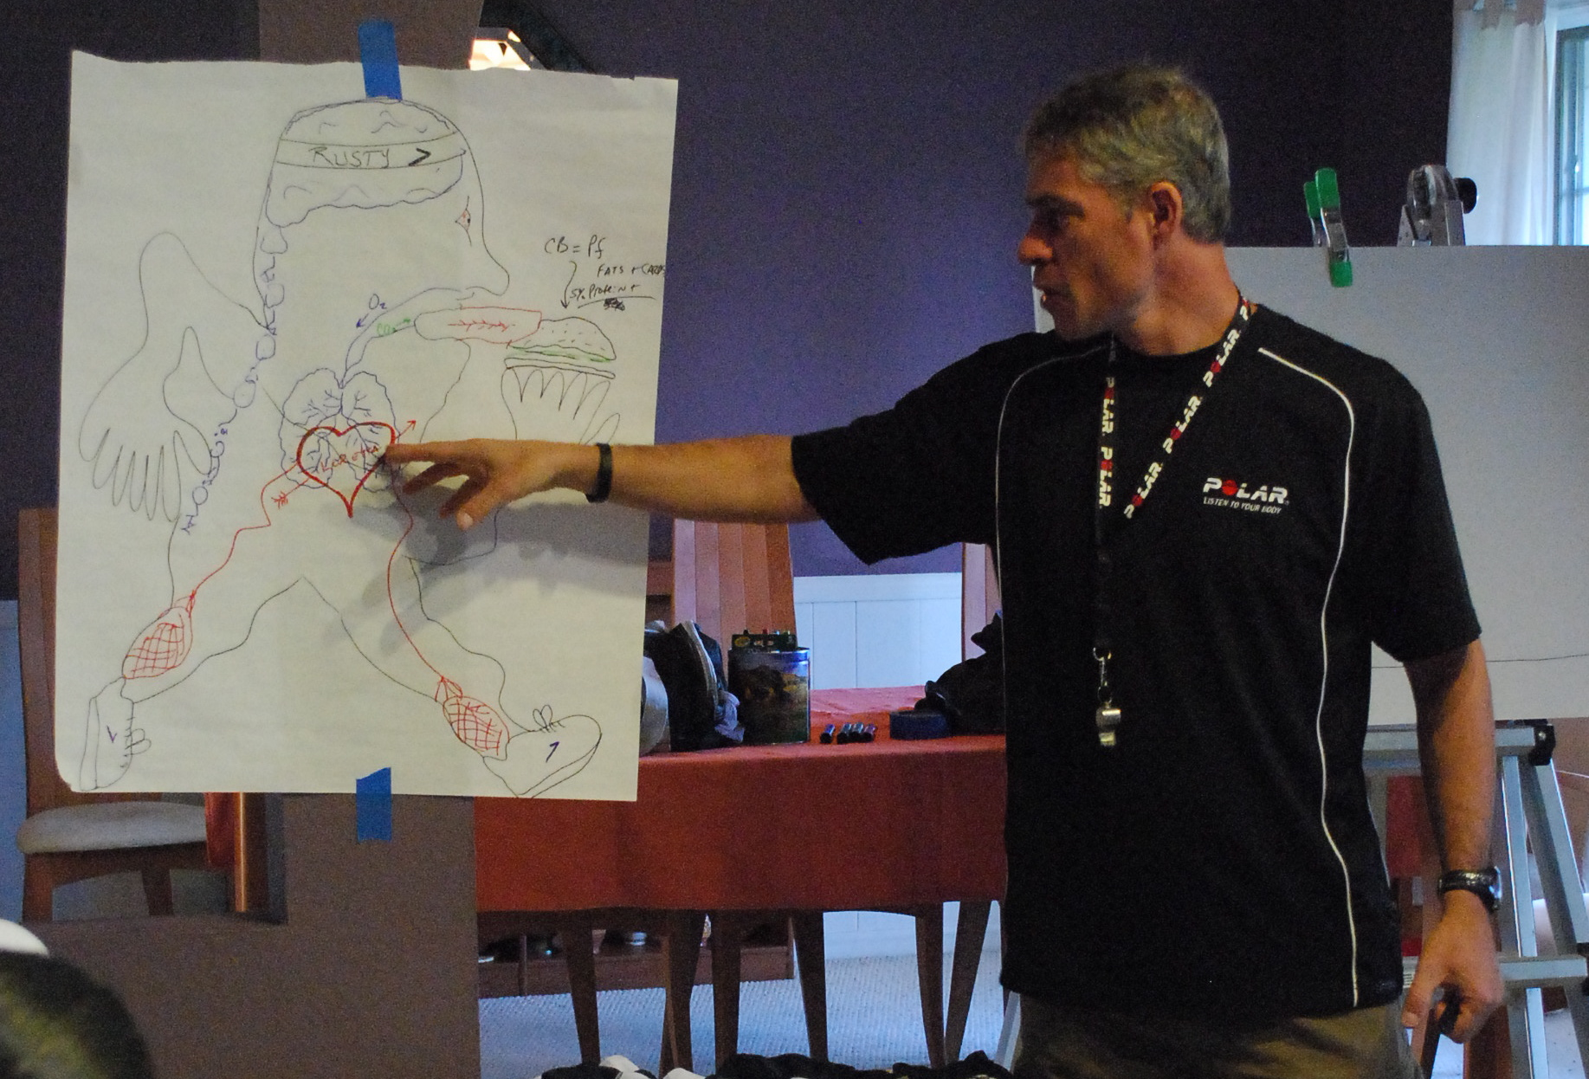
Remember this guy?

Slide 6
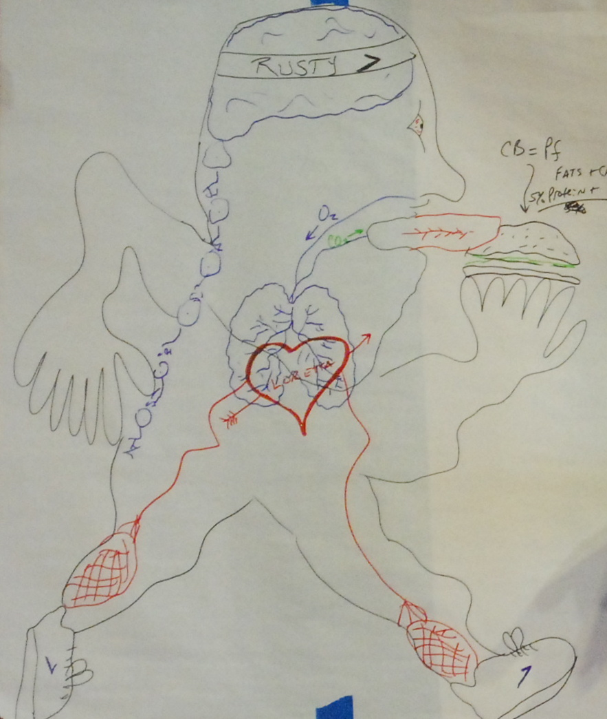
This is YOU racewalking, burning fats, carbs. and protein, in association with OXYGEN, for energy.

Slide 7
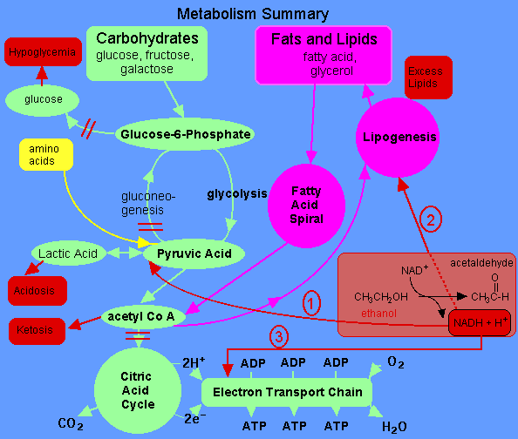
Although there are a number of different metabolic pathways to turn food into energy…

Slide 8
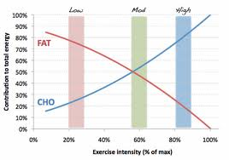
…and your body will find a way to get the job done, one way or another, some fuel sources and metabolic pathways are better than others.

Slide 9
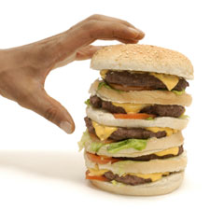
Fats have a bit of a bad reputation, but they are high in energy (9 calories/gram vs. 4 each for protein and carbs.,) plentiful in the body (!) and “clean burning,” breaking down into energy (ATP), and easily exhaled carbon dioxide and water vapor when burned.

Slide 10
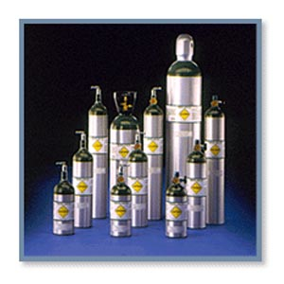
The main downside to using fat as a fuel source for exercise is that it requires a lot of oxygen to burn fat, so although it works well for long, slow training and racing, fat is not an effective fuel source for high-speed training or racing.

Slide 11
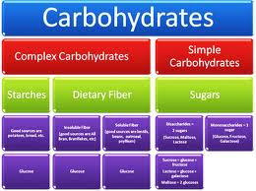
Carbs. are another great fuel source that, unlike fats, are able to be used effectively whether going long or short, slow or fast.

Slide 12
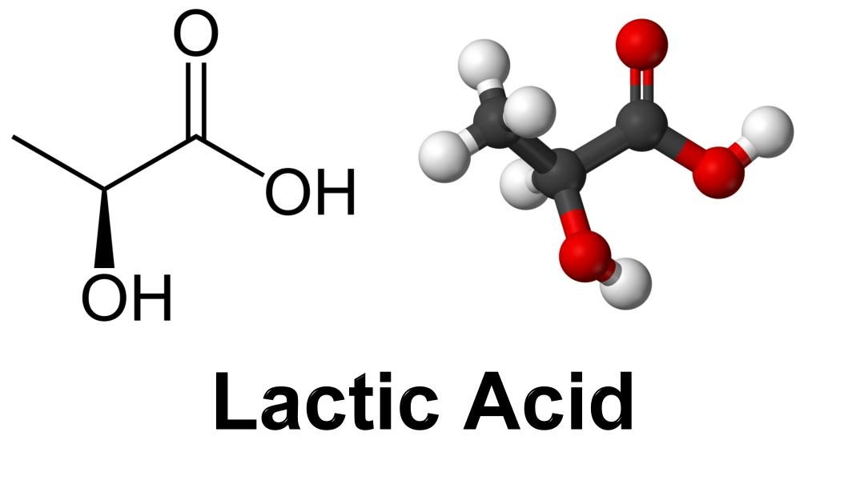
The downside to carbohydrate/glucose
The downside to using carbohydrates/glucose as a fuel source is that lactic acid is produced as a byproduct. Although lactate/lactic acid can be used as a fuel for exercise, it is acidic and can inhibit muscle contractions if too much of it accumulates in the muscles.

Slide 13
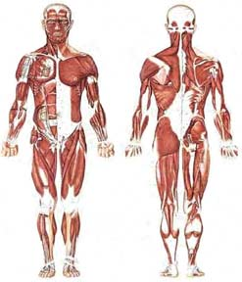
Slow-twitch muscle fibers tend to burn fat, and as a result don’t produce much lactic acid; Fast-twitch fibers tend to burn carbohydrates/glucose. They contract more quickly and powerfully than slow-twitch fibers, but they produce lots of fatiguing lactic acid as a byproduct.

Slide 14
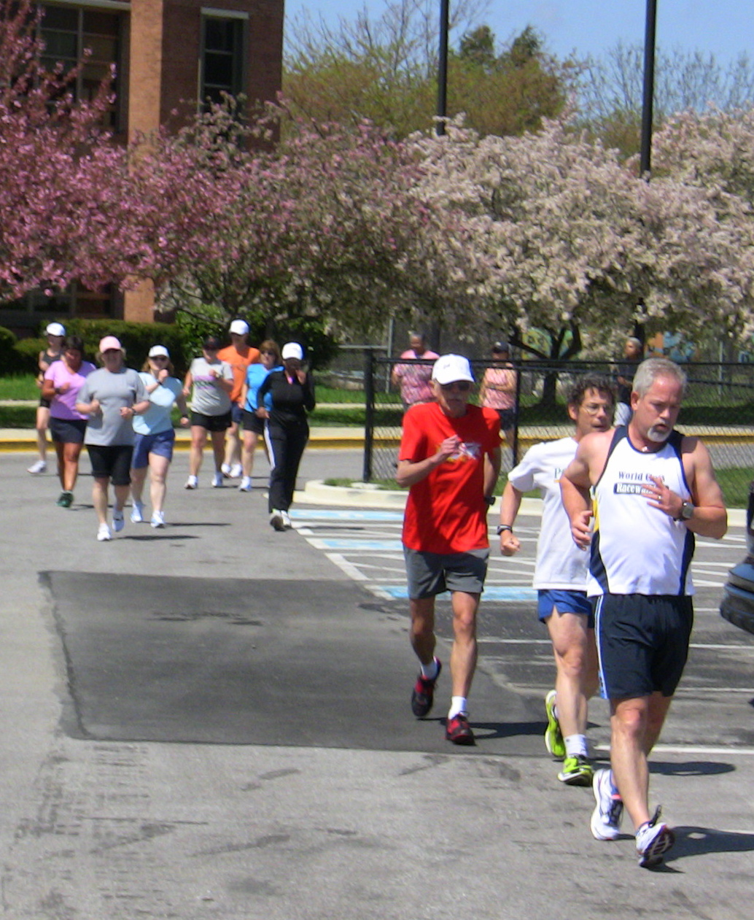
The bulk of race-walk training should be easy to moderate paced distance work, with a sprinkling of faster threshold work and high-end speed work.

Slide 15
The Training Pyramid
Economy
???
Endurance (Long Slow Distance and Long Sub-Threshold) 65-75% for LSD, up to 80%+ for LST
Recovery
Usually 65-75%, but could be as low as 60% on VERY easy days
Lactate threshold (intervals, fartleks, tempos, progressions, etc. About 85% of max heart rate for tempos, 90-92% for intervals and fartleks
VO2 max 95-98% of Max. Heart Rate USE SPARINGLY!

Slide 16
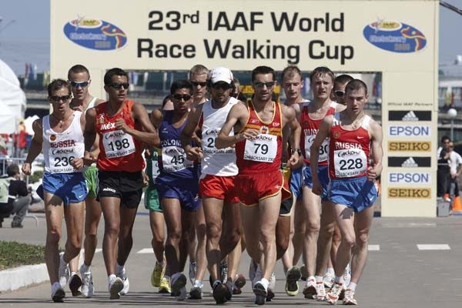
As endurance athletes, racewalkers must pile on the miles to train their “Type IIA” fibers to work oxidatively, like slow-twitch fibers. Too much speedwork can make the muscles work glycolytically, resulting in excessive lactate production and fatigue. Endurance work also builds a stronger heart, develops lots of capillaries and boosts hemoglobin levels to supply more oxygen to the working muscles.

Slide 17
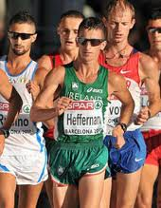
Faster training should take the form of very short, very fast “economy” work, mainly for technique development, and longer, more moderately paced “lactate threshold” training to hone racing speed.

Slide 18
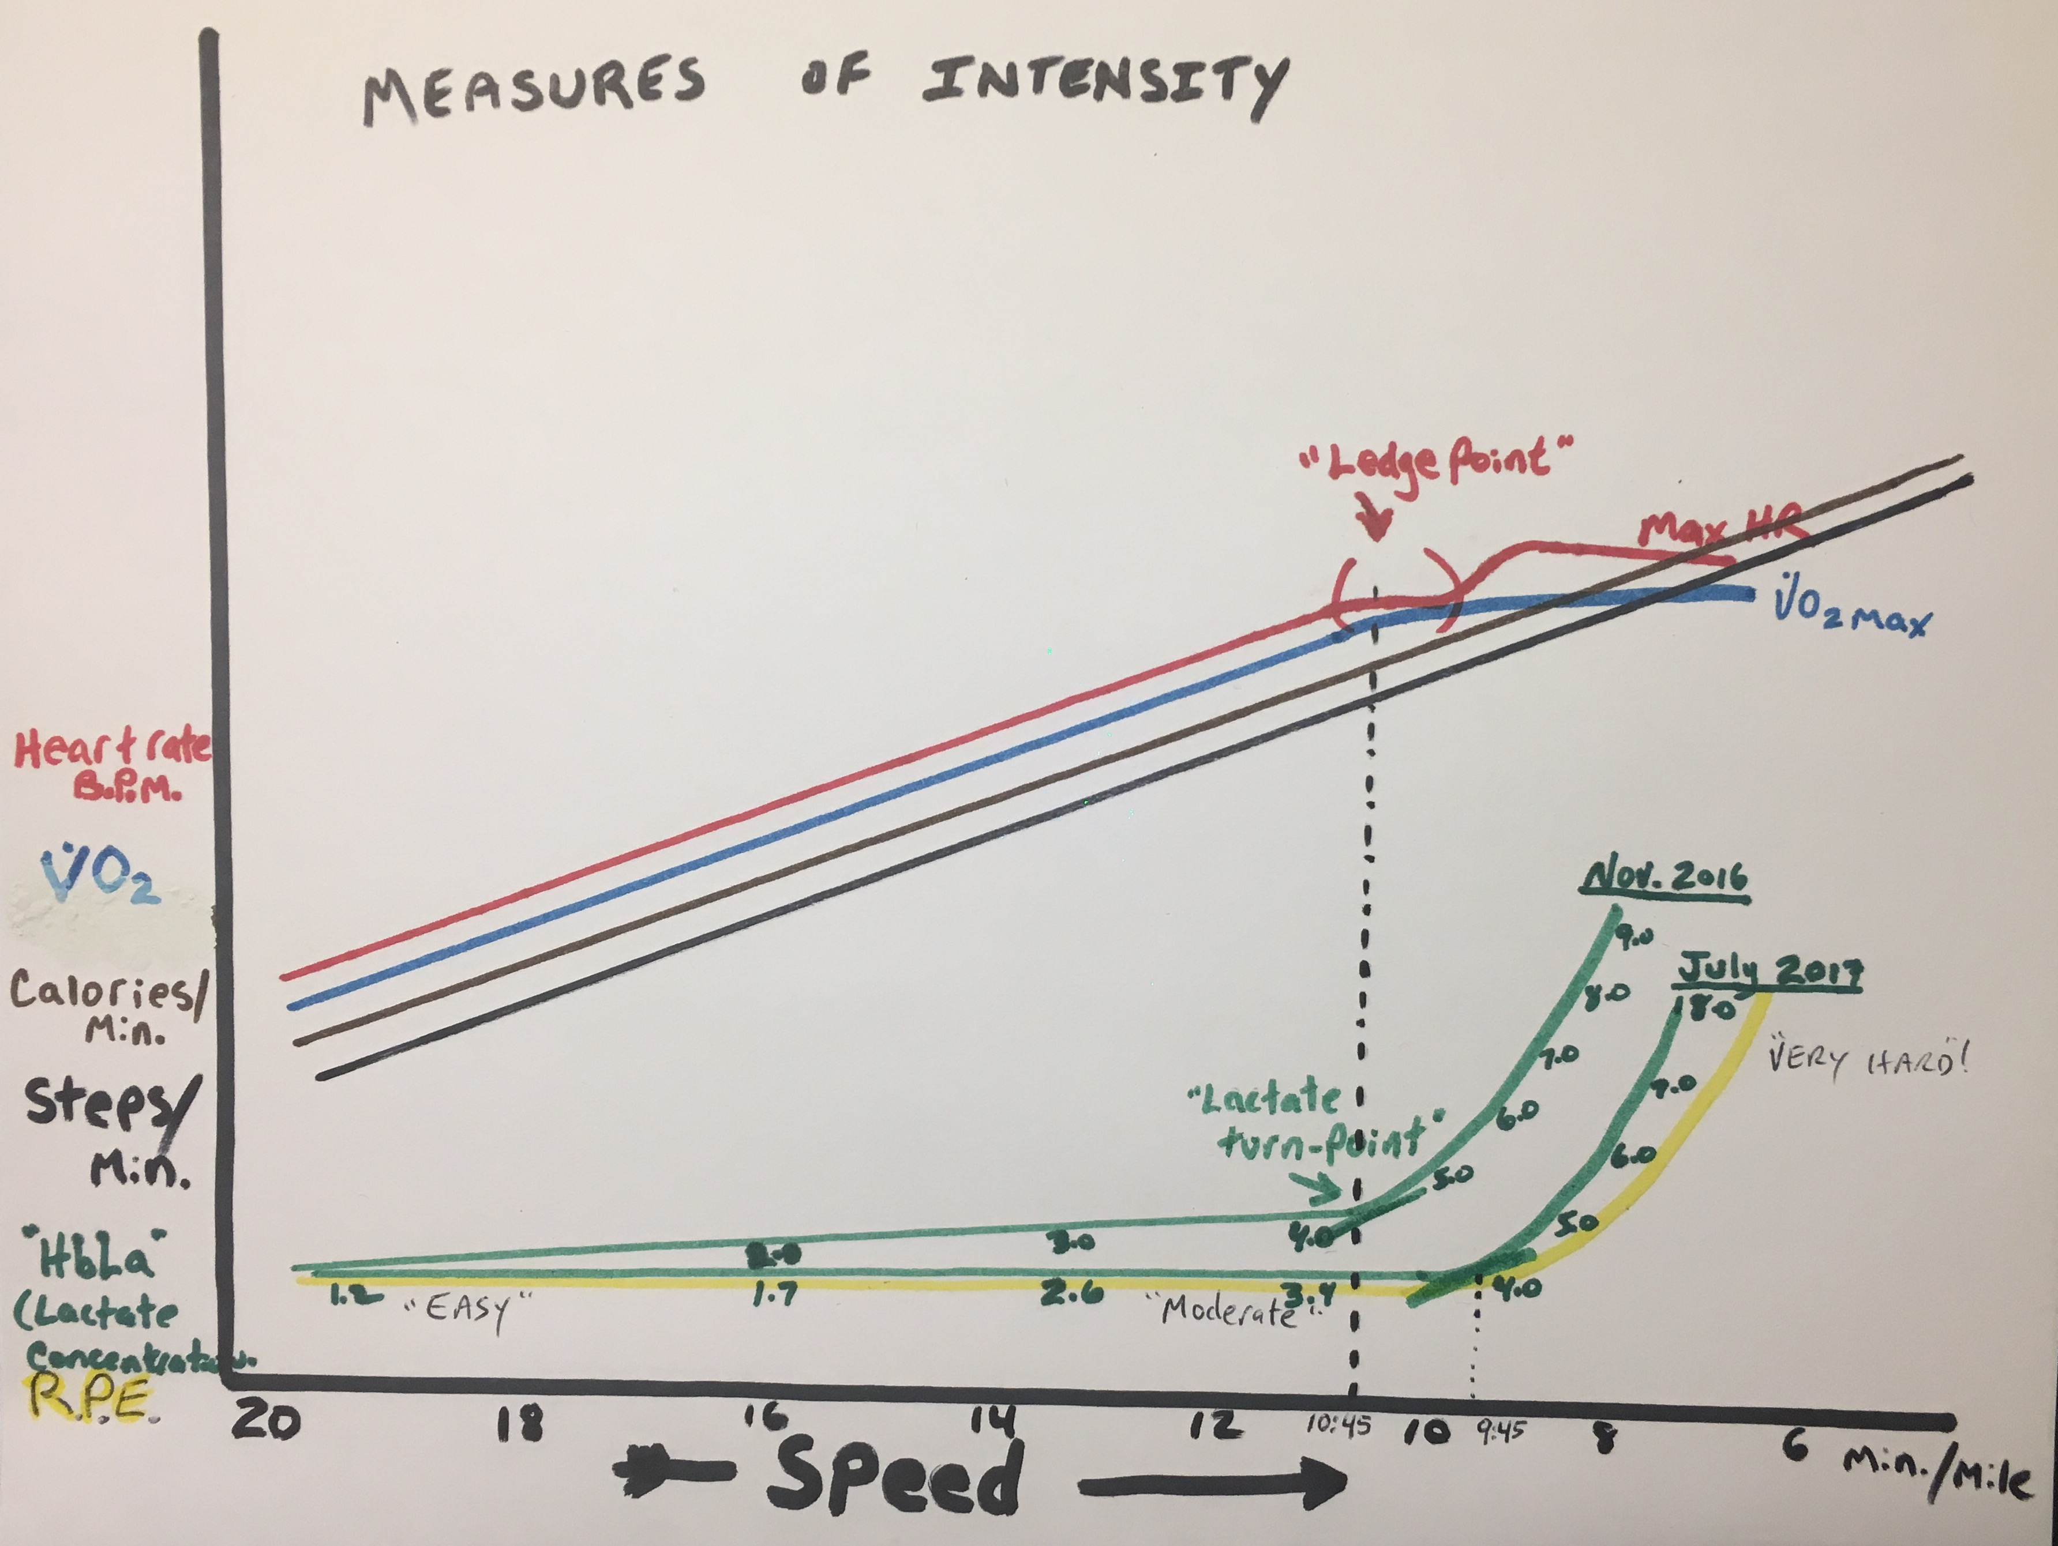
Cadence, heart rate, % of VO2 max, rating of perceived exertion (RPE), speed and lactate levels can all be used to measure intensity. In our 3 x 8:00 test we use heart rate because it is an easy to measure and accurate gauge of intensity.

Slide 19
There’s a lot going on in this one... As you walk faster, cadence, caloric consumption, heart rate and oxygen consumption rise steadily. At a certain point you can’t take in and process any more oxygen, so VO2 levels off as does heart rate. This leveling off causes lactate levels to rise. This point is known as the lactate threshold.

Slide 20
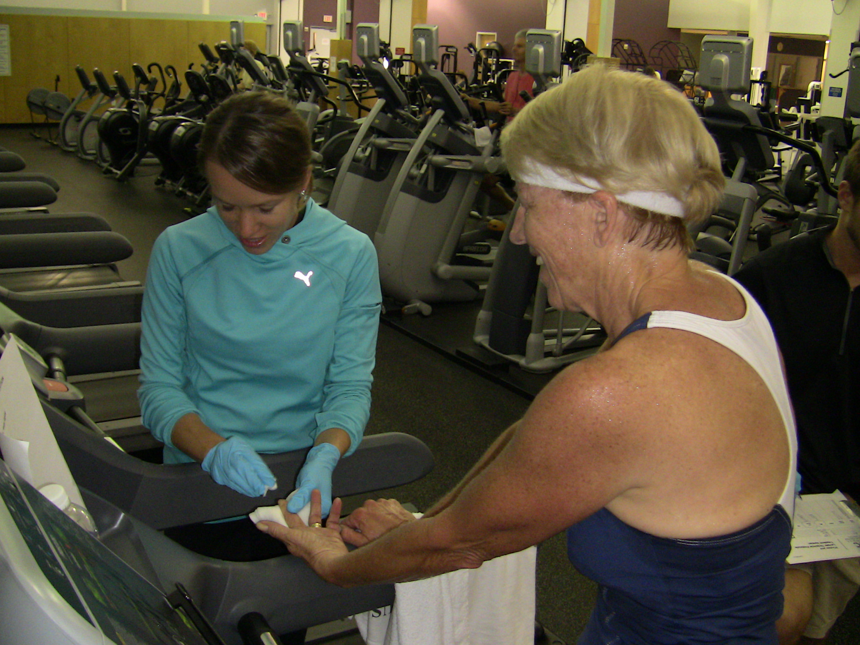
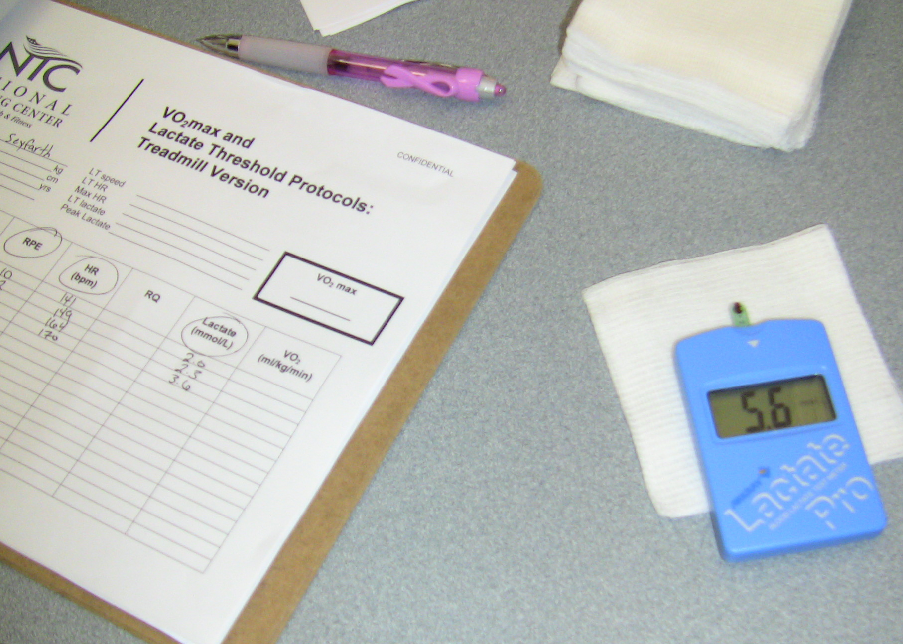
Blood lactate testing gives very accurate results…
…but true lactate testing is very difficult to perform on more than one or two people at a time.

Slide 21
Hence our heart rate field test. Since lactate and heart rate (as well as VO2 max and other physiological variables) are closely linked, changes in heart rate can give a good idea what’s going on inside.

Slide 22
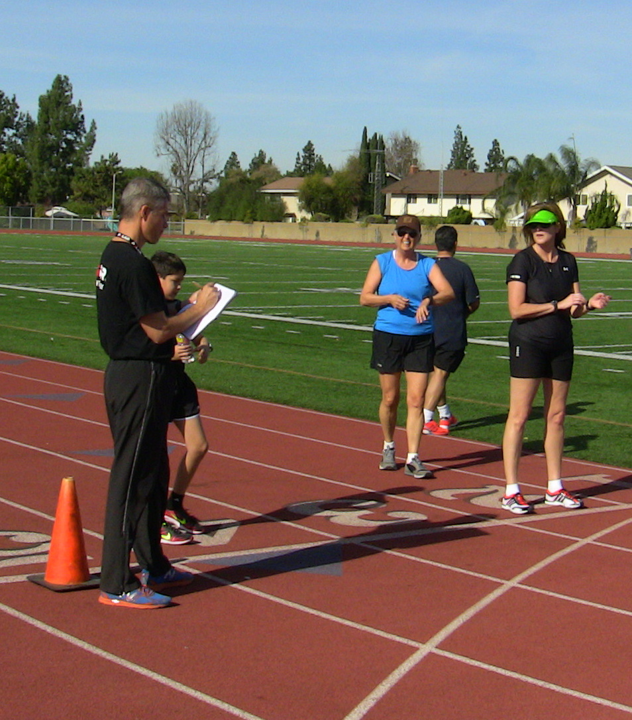
The 3 x 8:00 test is a reasonably accurate way of determining both lactate threshold and maximum heart rates, as long as the athlete is able to push heart rate to about 90% of maximum.

Slide 23
Results!
The results were mixed, but most of the group were able to get their heart rates high enough to be able to find threshold and maximum heart rates. We went over some of the results during the review session, so you have an idea how we got here. I’ve calculated all of the zone for you in the tables on the next two slides.

Slide 24
Threshold Test Results
 | 60-70% Recovery | 65-75% Easy distance | 80-85% Long sub-threshold | 85-90% Tempo | 90-92% Threshold intervals | 95-98% VO2max intervals | Max.
Example: | 120-140 | 130-150 | 160-170 | 170-180 | 180-184 | 190-196 | 200
Your results:

Slide 25
OK. Now what do I do with it?!
Knowing your maximum heart rate allows you to gauge the intensity of your training in an objective way. Although you may have seen formulas for determining maximum heart rate (220 – age = MHR; 185 – ½ age = MHR; etc.) these are based on population averages, not on what YOUR heart is doing! By using the numbers derived from the test you have a much more accurate way of using heart rate to gauge the intensity of your training.

Slide 26
Your training will consist of different workouts done at different intensities.
Some days will be very easy recovery days at 60-70% of maximum heart rate (MHR); other days will be harder. Harder workouts will consist of endurance workouts at 65-75% of MHR; “long sub-threshold” workouts at 80-85%; “tempo” walks at 85%; threshold intervals at 90-92%; VO2 max intervals at 95-98%; and economy intervals that are very fast, but too short (15 to 60 seconds) for the heart to fully respond, so heart rates may only jump to 85% or so before the interval ends.

Slide 27
The Training Pyramid
Economy
???
Endurance (Long Slow Distance and Long Sub-Threshold) 65-75% for LSD, up to 80%+ for LST
Recovery
Usually 65-75%, but could be as low as 60% on VERY easy days
Lactate threshold (intervals, fartleks, tempos, progressions, etc. About 85% of max heart rate for tempos, 90-92% for intervals and fartleks
VO2 max 95-98% of Max. Heart Rate USE SPARINGLY!

Slide 29
5k training with a recent best of 35:00 and a goal of 33:45
Monday | Tuesday | Wednesday | Thursday | Friday | Saturday | Sunday
Off | Easy 3 miles | Easy 3 miles | Easy 3 miles | Off | Easy 3 miles | Easy 4 miles
Off or easy cross-train | 1-mile warm-up, then 6-8 laps of “turns & straights” | Easy 3-4 miles | Easy 3-4 miles | Moderate 3-4 miles | Easy 3-4 miles | Easy 4.5 miles
Off or easy cross-train | 1-mile warm-up, then 10 x 200m fast w/ 200m breaks | Easy 4 miles | Easy 4 miles | Moderate 3-4 miles | Easy 4 miles | Easy 5 miles
Off or easy cross-train | 1-mile warm-up, then 12 x 200m fast w/ 200m breaks | Easy 4 miles | Easy 4 miles | 6k progression from moderate pace down to within 30 secs;/mile of goal pace | Easy 4 miles | Easy 5.5 miles
Off or easy cross-train | 1-mile warm-up, then 6 x 400m @ 5k goal pace w/ 200m breaks | Easy 4 miles | Easy 4 miles | Warm-up, then 5k tempo @ 45 seconds/mile slower than goal race pace | Easy 4 miles | Easy 6 miles
Off or easy cross-train | 1-mile warm-up, then 8 x 400m @ 5k goal pace w/ 200m breaks | Easy 4 miles | Easy 4 miles | 6k progression from moderate pace down to within 30 secs;/mile of goal pace | Easy 4 miles | Easy 7 miles
Off or easy cross-train | 1-mile warm-up, then 5 x 800m @ 5k goal pace w/ 400m breaks | Easy 4 miles | Easy 4 miles | 5k time-trial! | Easy 4 miles | Easy 8 miles
Off or easy cross-train | 1-mile warm-up, then 5 x 1,000m @ 5k goal pace w/ 400m breaks | Easy 4 miles | Easy 4 miles | 6k progression from moderate pace down to within 30 secs;/mile of goal pace | Easy 4 miles | Easy 8 miles
Off or easy cross-train | 1-mile warm-up, then 3 x 1 mile @ 5k goal pace w/ 400m breaks | Easy 4 miles | Easy 4 miles | 5k tempo @ 45 seconds/mile slower than goal race pace | Easy 4 miles | Easy 8 miles
Off or easy cross-train | 1-mile warm-up, then 5 x 1,000m @ 5k goal pace w/ 400m breaks | Easy 4 miles | Easy 4 miles | 6k progression from moderate pace down to a within 30 secs;/mile of goal pace | Easy 4 miles | Easy 8 miles
Off or easy cross-train | 1-mile warm-up, then 3 x 1 mile @ 5k goal pace w/ 400m breaks | Easy 4 miles | Easy 4 miles | 5k tempo @ 45 seconds/mile slower than goal race pace | Easy 4 miles | Easy 6 miles
Off or easy cross-train | 5k tempo @ 45 seconds/mile slower than goal race pace | Easy 3 miles | 1-mile warm-up, then 2 x 1k @ race pace. | Off | Easy 2k warm-up, then 4 x :30 secs. @ race pace | Goal: 33:45

Slide 30
10k training with a recent best of 1:12:30 and a goal of 1:10
Monday | Tuesday | Wednesday | Thursday | Friday | Saturday | Sunday
Off | Easy 4 miles | Easy 4 miles | Easy 4 miles | Off | Easy 4 miles | Easy 5 miles
Off or easy cross-train | 1-mile warm-up, then 8 x 200m fast w/ 200m breaks | Easy 4 miles | Easy 4 miles | Moderate 4 miles | Easy 4 miles | Easy 5.5 miles
Off or easy cross-train | 1-mile warm-up, then 10 x 200m fast w/ 200m breaks | Easy 4 miles | Easy 4 miles | Moderate 5 miles | Easy 4 miles | Easy 6 miles
Off or easy cross-train | 1-mile warm-up, then 12 x 200m fast w/ 200m breaks | Easy 4 miles | Easy 4 miles | 10k progression from moderate pace down to within 30 secs;/mile of goal pace | Easy 4 miles | Easy 7 miles
Off or easy cross-train | 1-mile warm-up, then 6 x 400m @ 5k goal pace w/ 200m breaks | Easy 4 miles | Easy 4 miles | Warm-up, then 8k tempo @ 45 seconds/mile slower than goal race pace | Easy 4 miles | Easy 8 miles
Off or easy cross-train | 1-mile warm-up, then 8 x 400m @ 5k goal pace w/ 200m breaks | Easy 4 miles | Easy 4 miles | 10k progression from moderate pace down to within 30 secs;/mile of goal pace | Easy 4 miles | Easy 9 miles
Off or easy cross-train | 1-mile warm-up, then 3 x 1 mile @ 10k goal pace w/ 400m breaks | Easy 4 miles | Easy 4 miles | 8k time-trial! | Easy 4 miles | “Not-so-easy” 6 miles (long sub-threshold)
Off or easy cross-train | 1-mile warm-up, then 6 x 1,000m @ 10k goal pace w/ 400m breaks | Easy 4 miles | Easy 4 miles | 10k progression from moderate pace down to within 30 secs;/mile of goal pace | Easy 4 miles | Easy 10 miles
Off or easy cross-train | 1-mile warm-up, then 4 x 1 mile @ 10k goal pace w/ 400m breaks | Easy 4 miles | Easy 4 miles | 10k tempo @ 45 seconds/mile slower than goal race pace | Easy 4 miles | “Not-so-easy” 8 miles (long sub-threshold)
Off or easy cross-train | 1-mile warm-up, then 4 x 2,000m @ 10k goal pace w/ 400m breaks | Easy 4 miles | Easy 4 miles | 10k progression from moderate pace down to a within 30 secs;/mile of goal pace | Easy 4 miles | Easy 12 miles
Off or easy cross-train | 1-mile warm-up, then 5 x 1 mile @ 10k goal pace w/ 400m breaks | Easy 4 miles | Easy 4 miles | 8k tempo @ 45 seconds/mile slower than goal race pace | Easy 4 miles | Easy 8 miles
Off or easy cross-train | 1-mile warm-up, then 3 x 1 mile @ 10k goal pace w/ 400m breaks | Easy 3 miles | 1-mile warm-up, then 2 x 1k @ race pace. | Off | Easy 2k warm-up, then 4 x :30 secs. @ race pace | Goal: 1:10:00

Slide 31
Half-marathon training with a best of 2:30 and a goal of 2:25
Monday | Tuesday | Wednesday | Thursday | Friday | Saturday | Sunday
Off | Easy 4 miles | Easy 4-5 miles | Easy 4-5 miles | Off | Easy 4-5 miles | Easy 6 miles
Off or easy cross-train | 1-mile warm-up, then 8 x 200m fast w/ 200m breaks | Easy 4-5 miles | Easy 4-5 miles | Moderate 5 miles | Easy 4-5 miles | Easy 7 miles
Off or easy cross-train | 1-mile warm-up, then 10 x 200m fast w/ 200m breaks | Easy 4-5 miles | Easy 4-5 miles | Moderate 6 miles | Easy 4-5 miles | Easy 8 miles
Off or easy cross-train | 1-mile warm-up, then 12 x 200m fast w/ 200m breaks | Easy 4-5 miles | Easy 4-5 miles | 10k progression from moderate pace down to within 30 secs;/mile of goal pace | Easy 4-5 miles | Easy 9 miles
Off or easy cross-train | 1-mile warm-up, then 6 x 400m @ 5k goal pace w/ 200m breaks | Easy 4-5 miles | Easy 4-5 miles | Warm-up, then 10k tempo @ 45 seconds/mile slower than goal race pace | Easy 4-5 miles | “Not-so-easy” 6 miles (long sub-threshold)
Off or easy cross-train | 1-mile warm-up, then 8 x 400m @ 5k goal pace w/ 200m breaks | Easy 4-5 miles | Easy 4-5 miles | 12k progression from moderate pace down to within 30 secs;/mile of goal pace | Easy 4-5 miles | Easy 10 miles
Off or easy cross-train | 1-mile warm-up, then 8 x 1,000m half-mar. pace w/ 400m breaks | Easy 4-5 miles | Easy 4-5 miles | Warm-up, then12k tempo @ 45 seconds/mile slower than goal race pace | Easy 4-5 miles | “Not-so-easy” 8 miles (long sub-threshold)
Off or easy cross-train | 1-mile warm-up, then 5 x 1 mile @ half-mar. pace w/ 400m breaks | Easy 4-5 miles | Easy 4-5 miles | 15k time-trial! | Easy 4-5 miles | Easy 10 miles
Off or easy cross-train | 1-mile warm-up, then 6 x 1 mile @ half-mar. pace w/ 400m breaks | Easy 4-5 miles | Easy 4-5 miles | 12k progression from moderate pace down to within 30 secs;/mile of goal pace | Easy 4-5 miles | “Not-so-easy” 10 miles (long sub-threshold)
Off or easy cross-train | 1-mile warm-up, then 5 x 2,000m half-mar. pace w/ 400m breaks | Easy 4-5 miles | Easy 4-5 miles | 15k tempo @ 45 seconds/mile slower than goal race pace | Easy 4-5 miles | Easy 10-12 miles
Off or easy cross-train | 1-mile warm-up, then 6 x 1 mile @ half-mar. pace w/ 400m breaks | Easy 4-5 miles | Easy 4-5 miles | 10k progression from moderate pace down to a within 30 secs;/mile of goal pace | Easy 4-5 miles | 9 miles as 6 easy, 3 at goal pace
Off or easy cross-train | 1-mile warm-up, then 3 x 1 mile @ half-mar. pace w/ 400m breaks | Easy 3 miles | 1-mile warm-up, then 2 x 1 mile @ race pace. | Off | Easy 2k warm-up, then 4 x :30 secs. @ race pace | Goal: 2:25:00

Slide 32
Marathon training with a best of 6:00 and a goal of 5:50
Monday | Tuesday | Wednesday | Thursday | Friday | Saturday | Sunday
Off | Easy 4 miles | Easy 4-5 miles | Easy 4-5 miles | Off | Easy 4-5 miles | Easy 10 miles
Off or easy cross-train | Easy 4-5 miles | Easy 5 miles | Easy 4-5 miles | Moderate 5 miles | Easy 4-5 miles | Easy 12 miles
Off or easy cross-train | Easy 4-5 miles | Moderate 5 miles | Easy 4-5 miles | Moderate 6 miles | Easy 4-5 miles | “Not-so-easy” 10 miles (long sub-threshold)
Off or easy cross-train | Easy 4-5 miles | Moderate 5 miles | Easy 4-5 miles | 10k progression from moderate pace down to within 30 secs;/mile of goal pace | Easy 4-5 miles | Easy 14 miles
Off or easy cross-train | 1-mile warm-up, then 6 x 400m @ 5k goal pace w/ 200m breaks | Easy 4-5 miles | Easy 4-5 miles | Warm-up, then 10k tempo @ 45 seconds/mile slower than goal race pace | Easy 4-5 miles | “Not-so-easy” 10 miles (long sub-threshold)
Off or easy cross-train | 1-mile warm-up, then 8 x 400m @ 5k goal pace w/ 200m breaks | Easy 4-5 miles | Easy 4-5 miles | 12k progression from moderate pace down to within 30 secs;/mile of goal pace | Easy 4-5 miles | Easy 16 miles
Off or easy cross-train | 1-mile warm-up, then 8 x 1,000m half-mar. pace w/ 400m breaks | Easy 4-5 miles | Easy 4-5 miles | Warm-up, then12k tempo @ 45 seconds/mile slower than goal race pace | Easy 4-5 miles | “Not-so-easy” 12 miles (long sub-threshold)
Off or easy cross-train | 1-mile warm-up, then 5 x 1 mile @ half-mar. pace w/ 400m breaks | Easy 4-5 miles | Easy 4-5 miles | 15k progression from moderate pace down to within 30 secs;/mile of goal pace | Easy 4-5 miles | Easy 18 miles
Off or easy cross-train | 1-mile warm-up, then 6 x 1 mile @ half-mar. pace w/ 400m breaks | Easy 4-5 miles | Easy 4-5 miles | Warm-up, then15k tempo @ 45 seconds/mile slower than goal race pace | Easy 4-5 miles | “Not-so-easy” 15 miles (long sub-threshold)
Off or easy cross-train | 1-mile warm-up, then 5 x 2,000m half-mar. pace w/ 400m breaks | Easy 4-5 miles | Easy 4-5 miles | 15k progression from moderate pace down to within 30 secs;/mile of goal pace | Easy 4-5 miles | Easy 20 miles
Off or easy cross-train | 1-mile warm-up, then 6 x 1 mile @ half-mar. pace w/ 400m breaks | Easy 4-5 miles | Easy 4-5 miles | 10k progression from moderate pace down to a within 30 secs;/mile of goal pace | Easy 4-5 miles | 9 miles as 6 easy, 3 at goal pace
Off or easy cross-train | 1-mile warm-up, then 3 x 1 mile @ half-mar. pace w/ 400m breaks | Easy 3 miles | 1-mile warm-up, then 2 x 1 mile @ race pace. | Off | Easy 2k warm-up, then 4 x :30 secs. @ race pace | Goal: 5:20

Slide 33
And now, finally…
The Big Secret:

